Slide 1
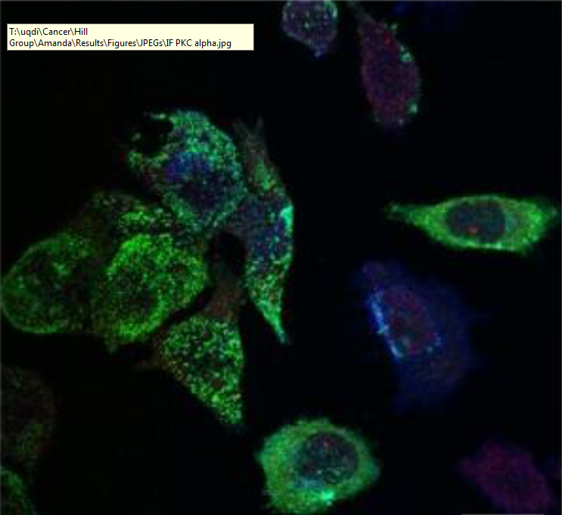
Selective export of microRNA via extracellular vesicles
Harley Robinson
Supervisor: Dr Michelle Hill
Co-supervisor: Dr Alex Cristino

Slide 2
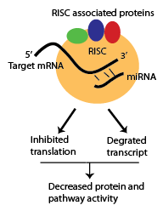
microRNAs
Important regulatory function
Binding to target mRNA decreases protein function by RISC inhibition and degradation (Gregory et al. 2005)
Export of microRNAs (miRs, miRNAs) regulates pathways in the recipient cells attributed to:
Cardiac homeostasis (Simons & Simons 2002)
Diabetes (Cohen et al 2003)
Cancer metastasis (Falcone et al 2015)
Notes:
What, how, export, diseases… Therefore, these miRNAs are considered important in intercellular communication.

Slide 3
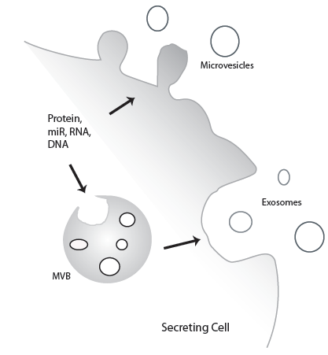
Extracellular Vesicles
Composed of microvesicles and exosomes.
Content regulate processes in recipient cells.
Surface contains homing proteins to allow for cell specific delivery
Important for intercellular communication.
Notes:
What, contents, advantages.. Hereby, investigating the content can reveal function or irregularities occurring in intercellular communication

Slide 4
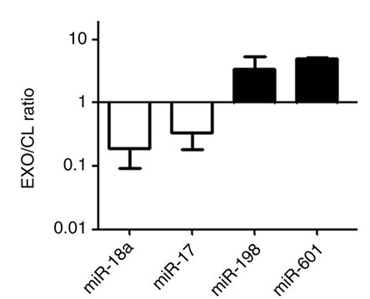
Current miRNA Cargo Sorting Mechanisms.
Previously considered non-selective
No longer considered entirely true.
miRNAs exported can change disproportionally to the cellular content
Sumoylated hnRNP A2B1 involved in miRNA export via exosomes. (Villarroya-Beltri et al 2013)
Regulation still unknown
(Villarroya-Beltri et al 2013)
Notes:
Very little is known about miRNA export. Previously non-selective (define). Link to slide as selective. hnRNP subset of 30miRs. No known regulation, no known mechanisms for the other miRs

Slide 5
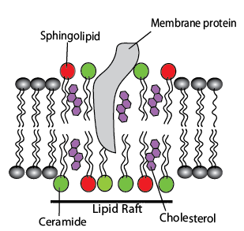
Lipid Rafts Affecting Cargo Sorting
Sorting may be impacted by lipid raft composition.
Both type of EVs contain cholesterol, sphingolipid and ceramide enriched microdomains.
Depletion of cholesterol, ceramide and sphingolipid modified EV protein content. (Leyt et al 2007; Trajkovic et al 2008; Phuyal et al 2014)
Re-distribution of lipid raft cholesterol correlates to protein and miRNA EV content. (Inder et al 2012, 2014)
Notes:
Lipid raft composition may be key.. Lipid rafts are.. Rafts enriched in.. Investigating the role of these lipid rafts through depletion..

Slide 6
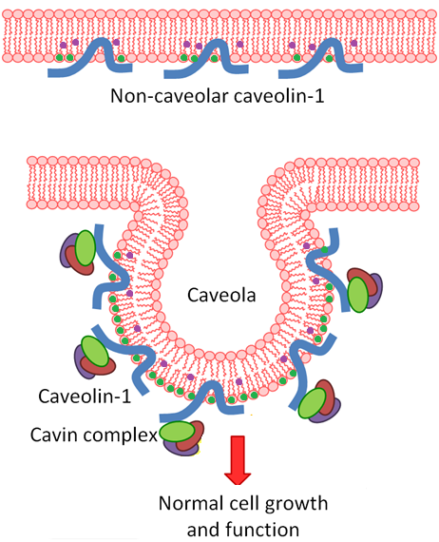
Advanced Prostate Cancer Cell Line: PC3
Increased Caveolin-1 expression without Cavins.
When accompanied by Cavin-1 it will form caveolae, utilised in Endocytosis.
Caveolin-1 is a cholesterol transporter
Caveolin-1 is a proposed biomarker for cancer.

Slide 7
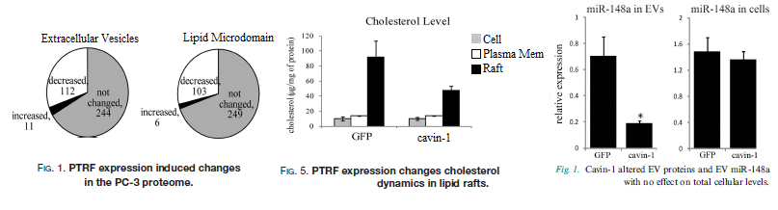
Cavins and lipid rafts
Introduction of Cavin-1 results in modulated cholesterol re-distribution, EV protein content and miR content.
RNA-binding proteins appear to be enriched within lipid rafts.
Hereby, modulation of miRNA export could be lipid raft dependent.
(Inder et al 2012; Inder et al 2014)

Slide 8
Hypotheses and Aims:
It is hypothesised that the introduction of Cavin-1 to a PC3 model will modify the EV miRNA content by activity of RNA binding proteins within lipid rafts.
Aims:
Identify the miRNAs that are selectively exported
Identify RNA-binding proteins correlated to the miRNA export
Verify candidate miRNA escort proteins ability to bind to miRNAs and transport to EVs.

Slide 9
Aim 1: Analysis of miRNA export
Method 1: Bioinformatics
Previous miRNA-seq data compiled for cell and EV fraction of PC3 GFP cells and PC3 cavin-1 transfected cells.
Using R packages to find fold change differences between Cavin-1 and GFP
Compare FC of cavin-1/GFP between cell and EV to find differentially exported miRs.
 | microRNA | baseMean | log2FoldChange | lfcSE | stat | pvalue | padj
Cell | hsa-miR-X | 58.297218 | 2.229358867 | 0.471440906 | 4.72882 | 2.26E-06 | 0.000276
EV | hsa-miR-X | 22.9440875 | 5.311894876 | 0.562070815 | 9.45058 | 3.90E-05 | 0.002001

Slide 10
Aim 1: Analysis of miRNA export. Cont.
Method 2: RT-qPCR
Using kits
Addition of poly-A tail
cDNA conversion
Average triplicates
Compare GFP to Cavin-1 to find Fold Change
T-Test
Expected results: Combination of selective and non-selectively exported miRNAs

Slide 11
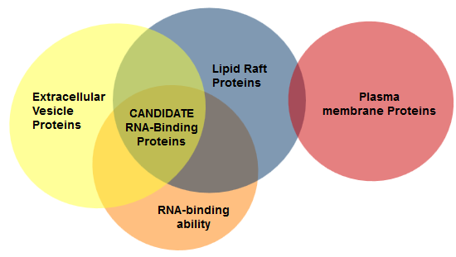
Aim 2: Identify candidate miR binding proteins.
Method 1: Computational analysis.
Previous proteomics data collected for the lipid raft, total membrane and EVs using tandem mass spectrometry for PC3 GFP and PC3 cavin-1 cells.
Identifying proteins enriched in the EV fraction correlating to an increase of miR export.
Perform Gene Ontology analyses to identify molecular function: RNA-binding ability.
Notes:
GO:0003723

Slide 12

Aim 2: Identify candidate miR binding proteins. cont.
Method 2: Motif discovery.
Literature search for known binding motif of candidate protein.
Alternatively…
Gibbs sampling to find shared motif in exported miRNAs
Probability based algorithm.
Expect a motif shared between all the exported miRNAs.
miR-198; GGUCCAGAGGGGAGAUAGGUUC
miR-887; CUUGGGAGCCCUGUUAGACUC

Slide 13
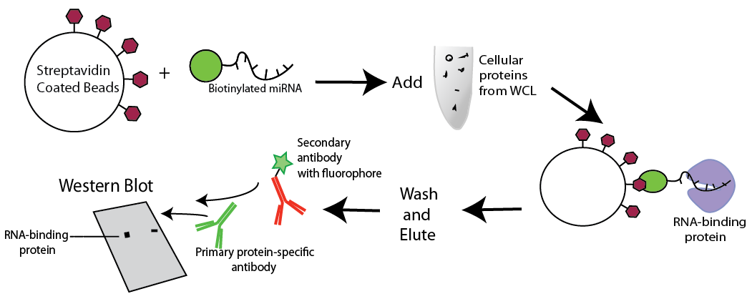
Aim 3: Verification of miR Candidate.
Method 1: Pull down assay

Slide 14
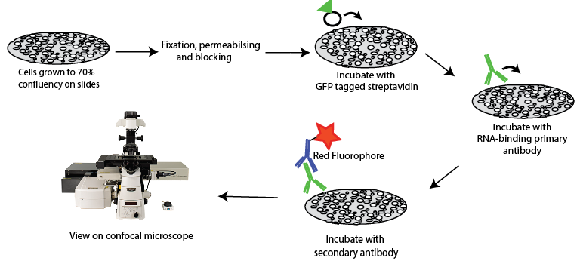
Aim 3: Verification of miR Candidate. Cont.
Method 2: Co-localisation by Immunofluorescence Confocal Microscopy
Cells transfected with biotinylated miRNAs
Co-localized miRNA + protein will be visualized as yellow.

Slide 15
Significance
Novel mechanism of lipid raft activity
Understanding underlying mechanisms surrounding miRNAs
MicroRNAs exported within EVs have been linked to cancer metastasis

